Slide 1

EASWARI ENGINEERING COLLEGE
AgriVision
AI-Driven Crop Disease Prediction via MERN Stack & CNN
SUBJECT : Full Stack Development
PRESENTED BY : MADHAN V M
310624104172
ZERO’TH REVIEW

Slide 2
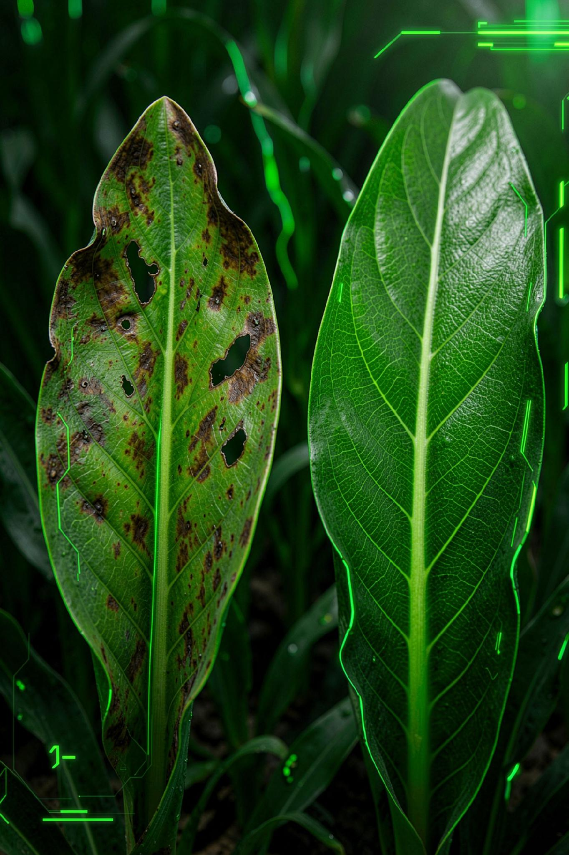
Table of Contents
01
02
Abstract
Problem Statement
03
04
Proposed Solution
Objectives
05
06
System Modules
System Workflow
07
08
Technology Stack
System Architecture
09
10
Expected Outcome
Conclusion

Slide 3
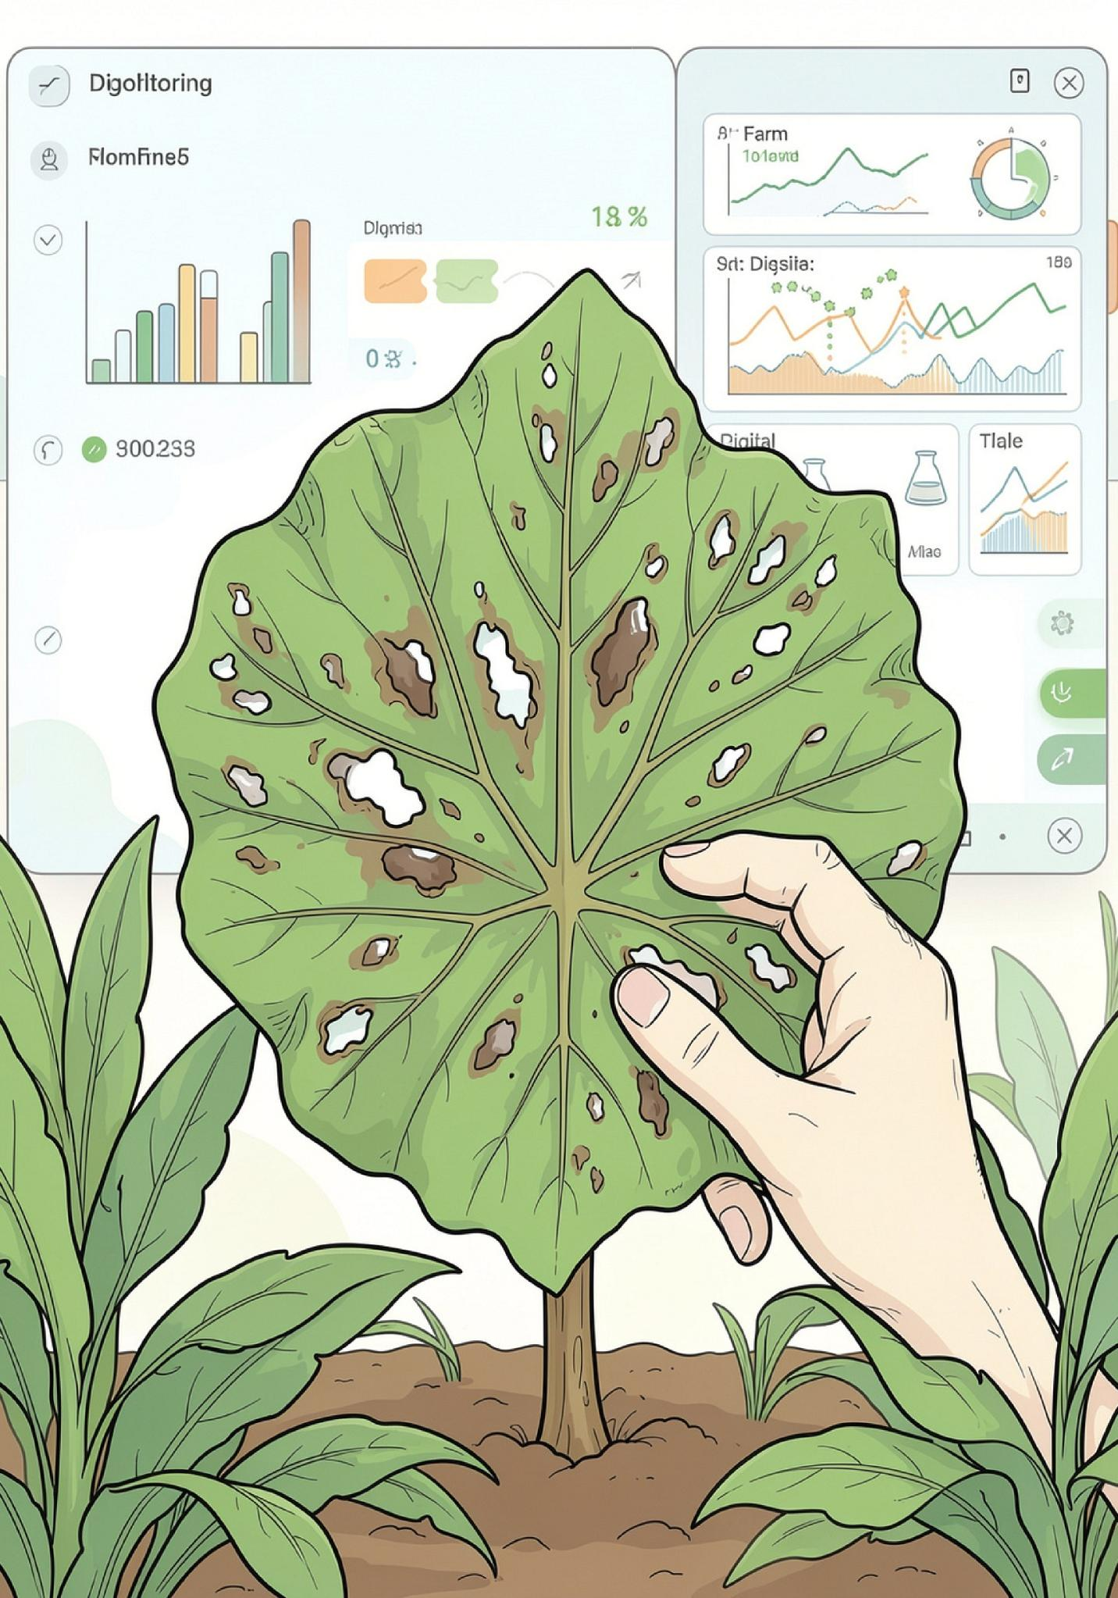

Abstract
Agricultural ecosystems face growing pressure from fungal and bacterial pathogens that degrade crop yield, threaten food security, and increase the burden on farm management teams. Monitoring bodies and farmers must track disease reports, verify affected sites, coordinate treatments, and record farm health readings, but these tasks are often handled through manual logs and disconnected communication channels that slow response times and reduce accuracy.
This project presents a web-based Crop Disease Tracking and Monitoring System that digitalizes and centralizes the entire workflow. Farmers can submit disease incidents, administrators can verify affected locations, and the integrated CNN model compares uploaded image readings against predefined disease thresholds to detect hazardous conditions early. Once treatment is verified, a digital agricultural report is generated and made available through a central dashboard, improving responsiveness, transparency, and decision-making in farm management.
Digital tracking can reduce reporting delays, improve verification accuracy, and enable faster treatment decisions for affected crops.
Manual reporting risks delay & poor tracking
Centralized digital platform
Auto threshold-based disease alerts

Slide 4
Problem Statement
Crop diseases are an escalating threat to global agriculture. Agricultural teams must track incoming disease reports from many sources, verify affected crops, assign experts, and record field data, typically relying on manual logs, scattered spreadsheets, and disconnected communication.
This creates delays in identifying outbreaks, makes it harder to coordinate treatments across teams, and increases the risk of incomplete or inconsistent farm records. Farmers and field officers need a centralized digital system that can manage the full lifecycle of a disease report, from submission and verification to treatment coordination and compliance tracking, with clear role-based access for farmers, field officers, and administrators.
MANUAL WORKFLOW FRICTION POINTS
Scattered, paper-based incident logs
Reports are captured inconsistently across notebooks, forms, and spreadsheets.
Difficult disease hotspot tracking
Teams struggle to see where outbreaks are spreading and which farms need attention first.
Time-consuming manual process
Every step from reporting to follow-up depends on repeated human checks and handoffs.
Delayed treatment response
Slow coordination can reduce the effectiveness of treatment and worsen crop damage.
Key challenges farmers face
Manual reporting slows down incident capture and increases the chance of errors
Delays in verification and escalation can allow disease to spread across fields
Lack of coordination makes it difficult to assign the right experts at the right time
Disjointed records make long-term tracking, compliance, and reporting unreliable

Slide 5
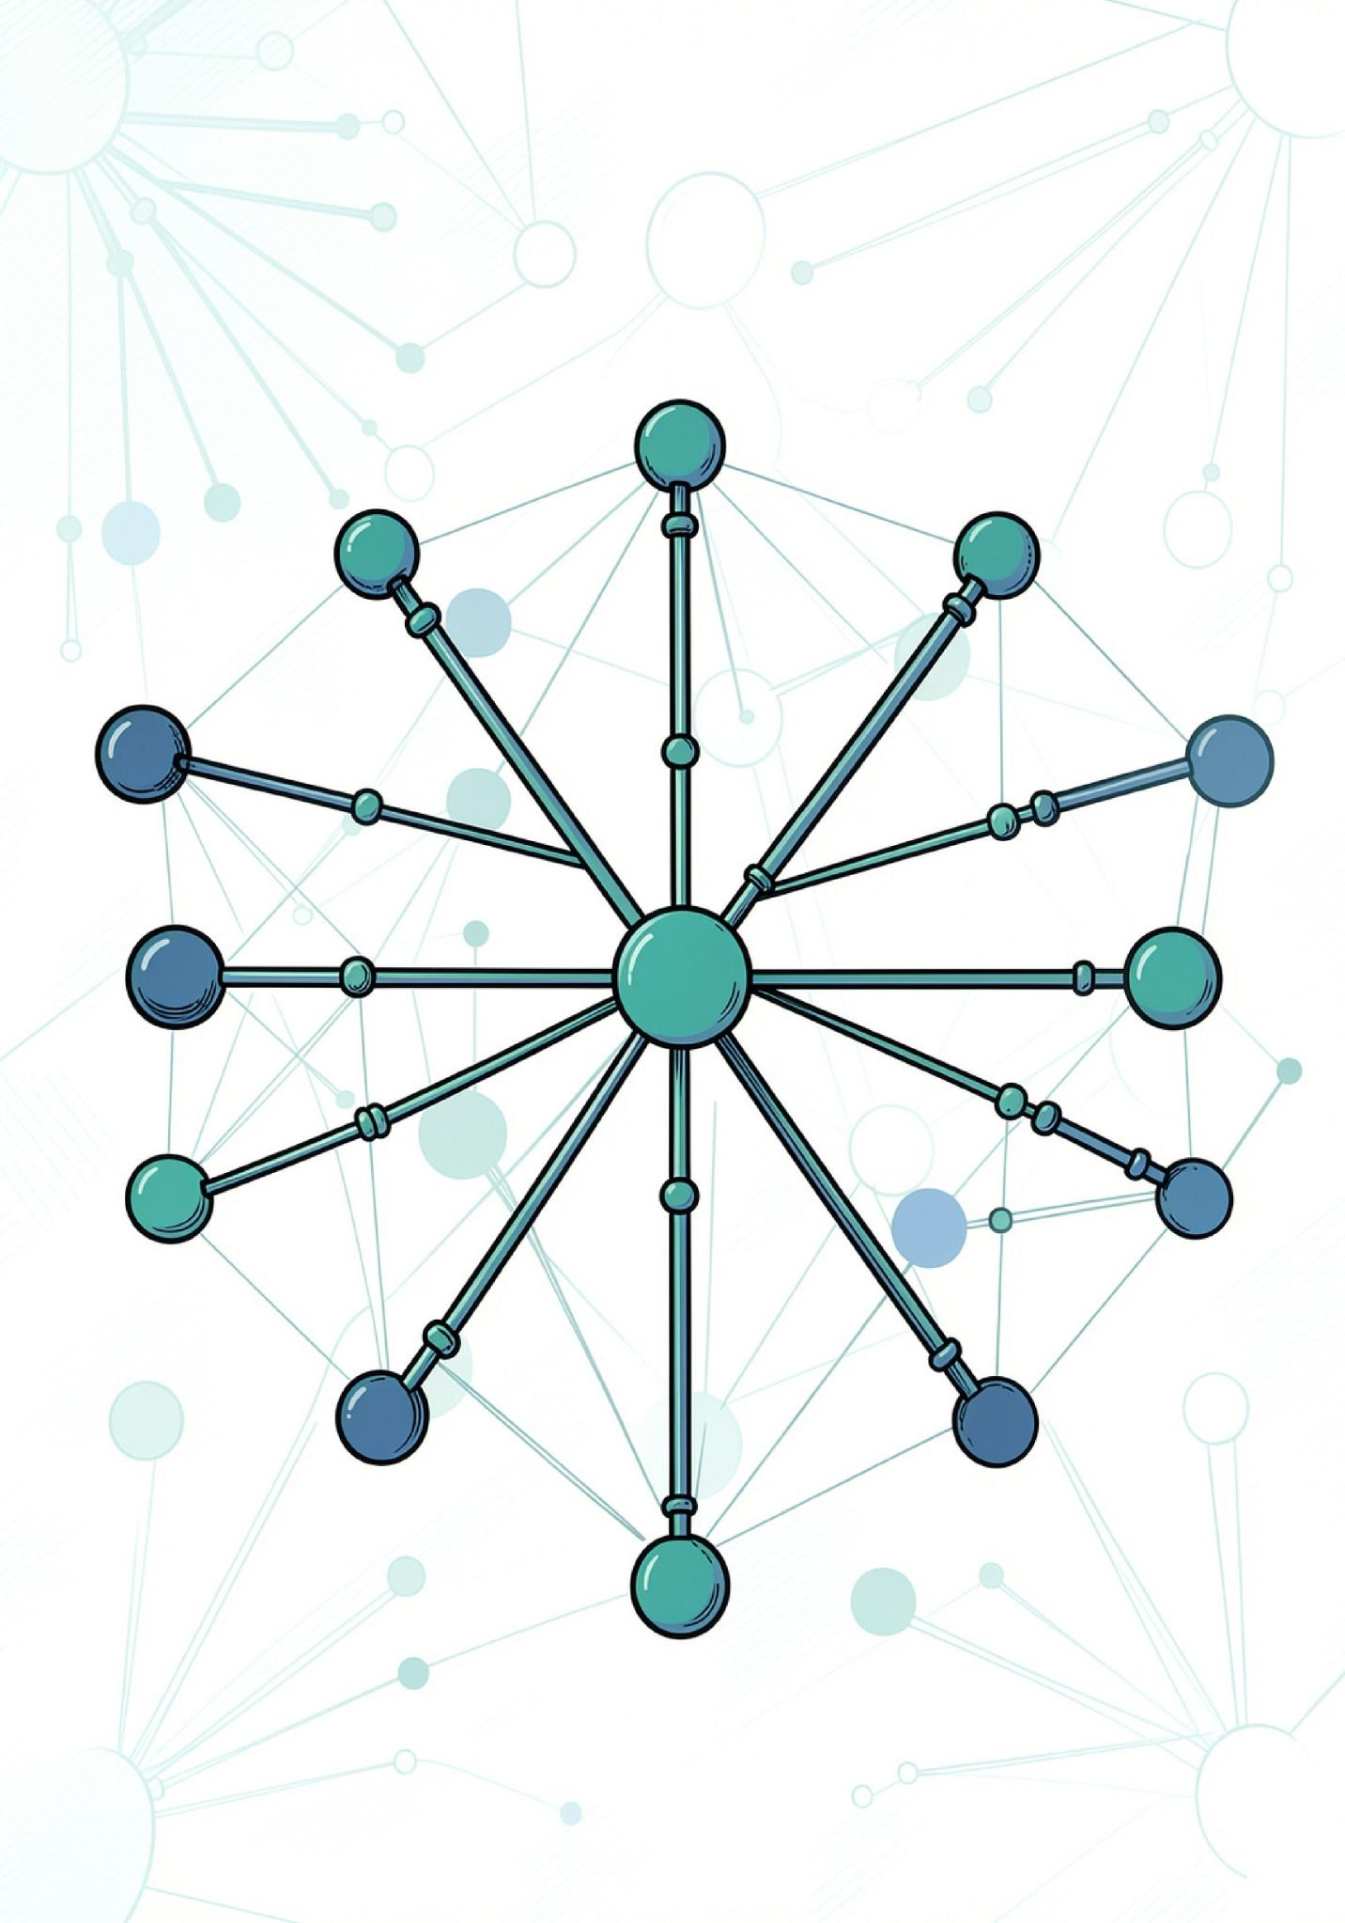
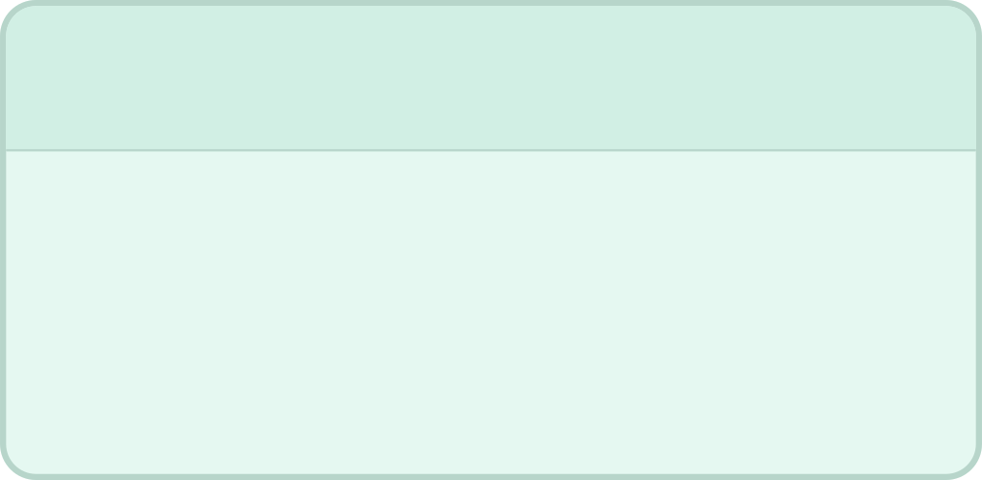


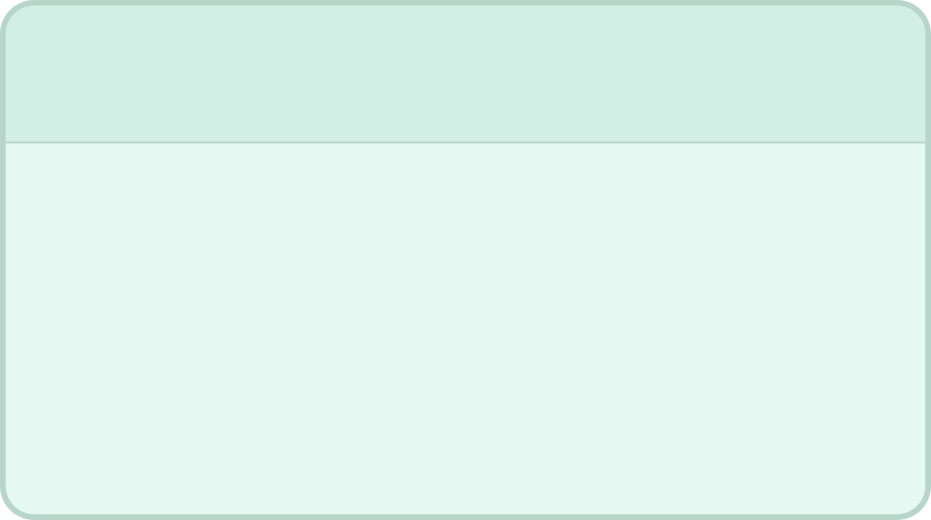


Proposed Solution
This platform is designed as a centralized web application that connects farmers, agricultural officers, and administrators within a single digital platform, transforming disease reporting and treatment coordination into a structured, trackable digital process.
Centralized platform
AI diagnosis
One system for farmers, officers, and administrators to manage every report.
Intelligent analysis helps identify likely disease patterns and status updates.
Real-time tracking
Treatment coordination
Monitor incidents, hotspots, and progress as reports move through the system.
Assign tasks, coordinate field action, and track treatment completion.

Slide 6
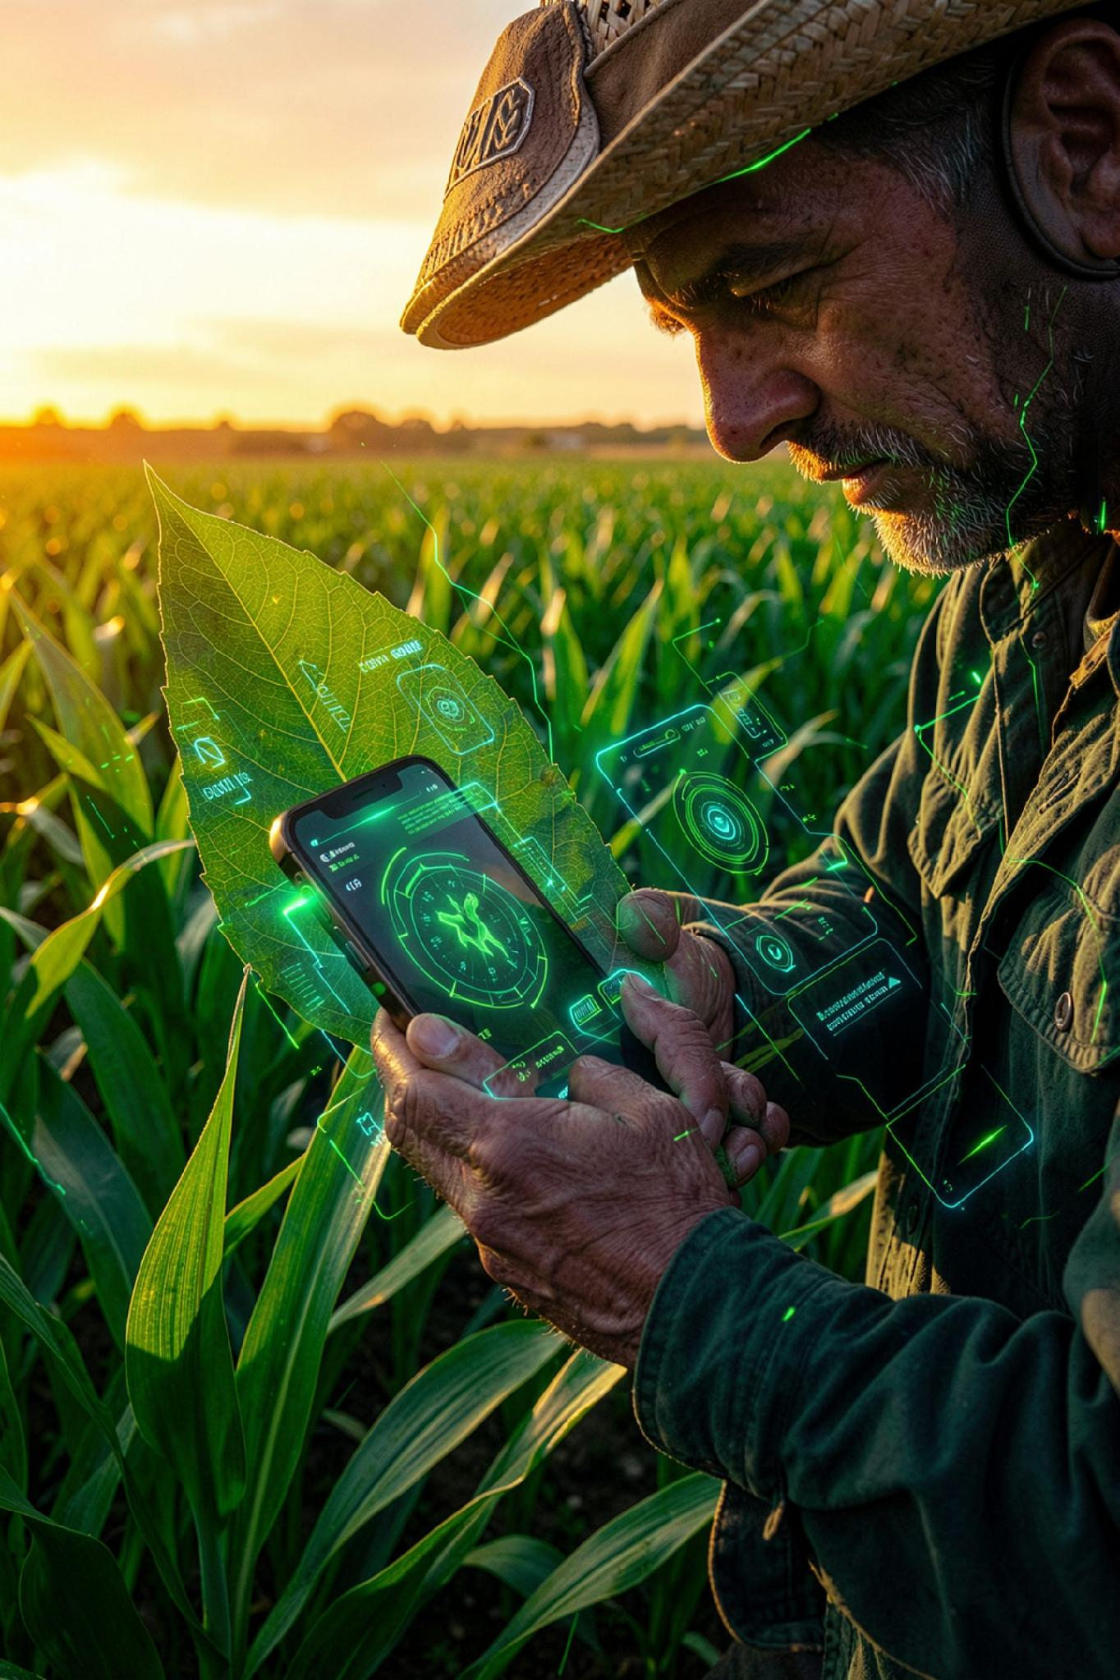
Project Objectives
🌿
01
Digitalize the crop disease reporting process.
🌿
02
Generate unique identification numbers for every report.
🌿
03
Provide role-based access for Farmers, Officers & Admins.
🌿
04
Enable farmers to record treatment and crop health data digitally.
🌿
05
Auto-compare CNN image classifications with predefined safe thresholds.
🌿
06
Identify compliant and non-compliant/hazardous plant states.
🌿
07
Improve disease incident tracking throughout its lifecycle.
🌿
08
Generate agricultural compliance reports after verification.
🌿
09
Reduce manual work and minimise diagnostic response delays.

Slide 7





Main System Modules
Farmer / Reporter Module
Agricultural Officer Module
Admin Module
AI Engine Module
Manage users, verify incoming reports, assign field officers, approve agricultural reports & monitor farm compliance.
Automatically evaluates uploaded leaf imagery against trained deep learning thresholds to determine disease hazard status.
Submit disease reports with location and image, monitor report status, and view resolution updates and environmental reports.
View assigned disease reports, record health readings and treatment actions, and update investigation status.

Slide 8
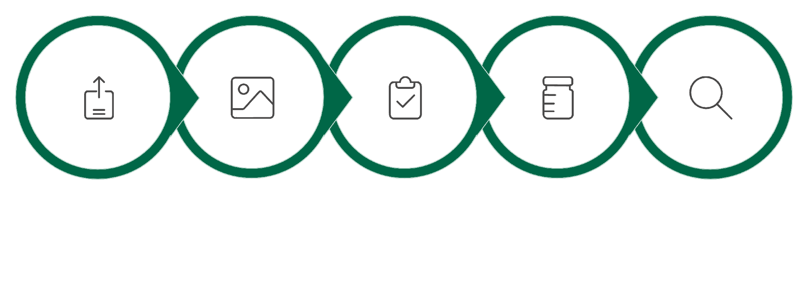
System Workflow
Submit Report
Treatment Assignment
Health Tracking
AI Analysis
Verification
Complete Report-to-Treatment Lifecycle — Fully Digital, Fully Tracked.

Slide 9

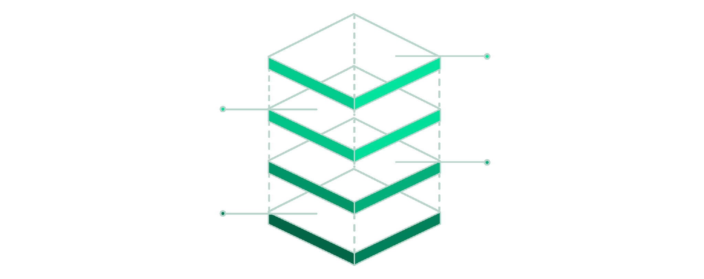



Technology Stack & System Architecture
React.js — Frontend
Responsive UIs, dashboards, incident forms and disease hotspot tracking pages.
Node.js + Express.js — Backend
AI Service
Python / TensorFlow inference
REST APIs, authentication, business logic, threshold calculations, report management.
Database
MongoDB storage layer
Backend
Node.js / Express APIs
MongoDB — Database
Frontend
React UI & dashboards
Stores users, reports, CNN readings, treatment records and compliance data.
Python / TensorFlow — AI Service
Handles image processing, model inference, and CNN tensor calculations.

Slide 10

AgriVision makes advanced AI actionable
What We Build
Why It Matters
A MERN-based web platform concept that connects authenticated users, image submission, CNN inference, prediction history, and treatment-oriented results through an AI microservice.
Accessible early screening can help farmers respond sooner, reduce avoidable yield loss, and support more sustainable agricultural decisions.
🌿 Leaf Anchor
🔗 API Contract
The differentiator is not the model — it is the complete workflow that puts the model in a farmer's hands.
Persistent visual identity across the entire system
Clean boundary between MERN and Python inference
Questions?
Presented by: [Madhan V M]
CLASS: [CSE III C]
REGISTER NUMBER : [310624104172]
📊 History
MongoDB-backed prediction logs for trend review
"From Image Capture to Verified Treatment."

